Slide 1
Shell Bootcamp 2024 3 Reflections for Week 3
Aranyaa A Khatawate
Date : 2-Sep-2024

Slide 2
About Me
Some phrases that best describe me include:
Open-minded
Sociable
Confident
Grateful
Creative
Please share an image / visual that best represents you

Slide 3

My learnings from this week!

Slide 4
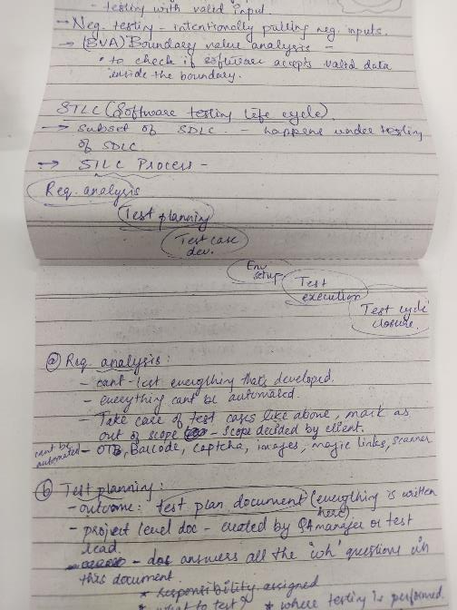
Learning 1 | My takeaways
Software testing hierarchy, functional and nonfunctional testing, white box, grey box, green box, black box,
Different types of testing – Smoke, regression, Performance, Ad Hoc
Negative testing, positive testing
STLC
Bugs/ tickets/ issues
Test drive development
User stories, scenarios, test cases
Bug report and bug life cycles

Slide 5
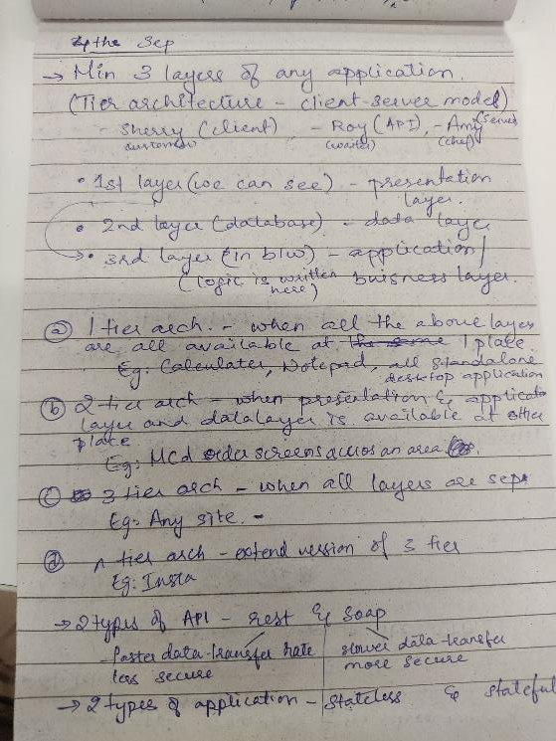
Learning 2 | My takeaways
Tier architecture – presentation layer, data layer, application layer
Github
Github actions - workflows
CI/CD pipelines
Cloud
Build management tools
Creation of Azure VM

Slide 6
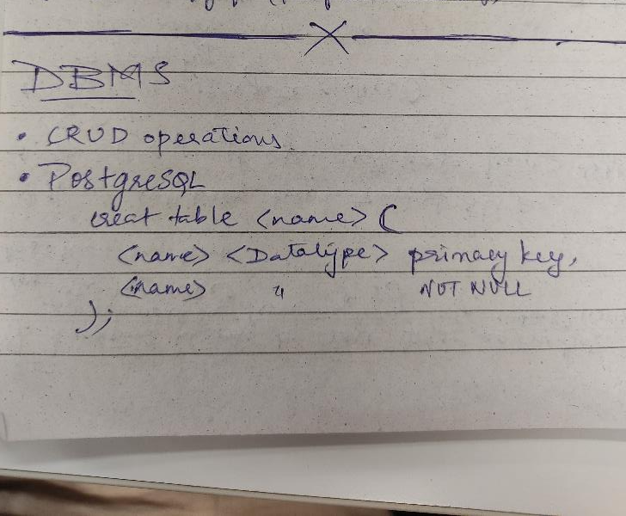
Learning 3 | My takeaways
PostGreSql
Database types – e.g. Relational, non-relational
SQL
Final case study – a complete run through of whatever was learnt

Slide 7

Relevance of learnings for my organization

Slide 8
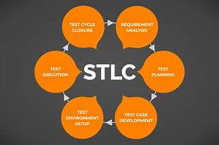
Learning 1 | Relevance for Shell
Every Software that is created must be tested before production. The types and levels of testing allow us to understand how testing is done
STLC is a Test life cycle that is to be followed
Writing of user stories is what helps create applications
Every application has bugs, and those bugs need to be recorded into a bug report that allows the team to mitigate the bug.
[Add a graphic that provides view of how Shell implements this learning]

Slide 9
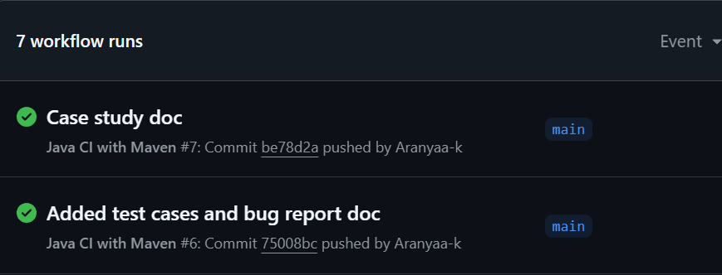
Learning 2 | Relevance for Shell
Teaches us how projects are handled in any company
CI/CD is a crucial part of the same.
GitHub allows us to create workflows that aids CI/CD for projects in development
Working on projects in Azure VMs allows security of any project.
Build tools like maven are used to facilitate CI/CD pipelines
Workflow runs for final case study

Slide 10
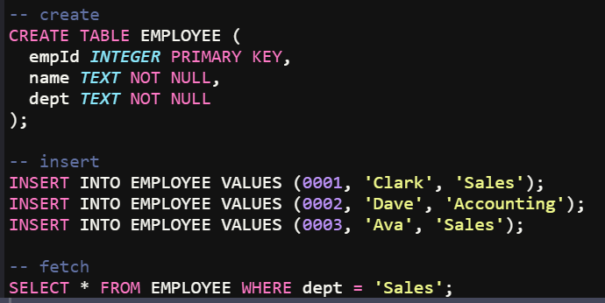
Learning 3 | Relevance for Shell
DBMS is essential to know before working on any project since every project needs data. Data is stored, retrieved, updated, deleted and managed using a database.
PostGreSQL is a Relational DBMS that Shell uses
Final case study was a run through of all the things learnt during the entire bootcamp

Slide 11

Challenges in implementing learning

Slide 12
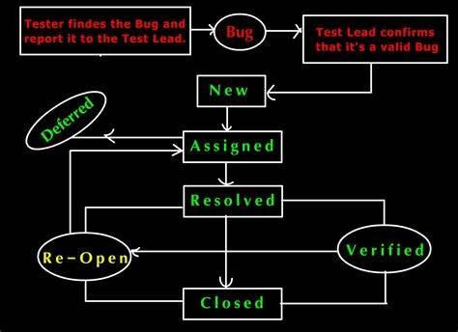
Challenge faced while implementing Learning 1
A lot of theory. A lot of steps, methods, terminologies and details to keep in mind

Slide 13
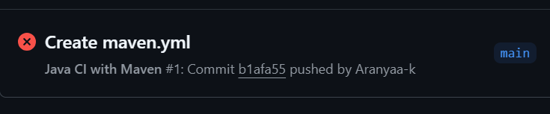
Challenge faced while implementing Learning 2
Build Fails when Actions and workflows were created for the first time
VM creation problems

Slide 14
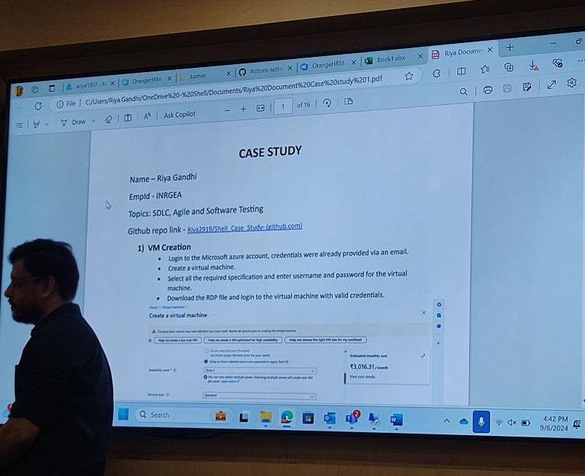
Challenge faced while implementing Learning 3
Time management of all the tasks given for the case study
Finding the bugs in the site OrangeHRM site
Document creation
Creation of VM during the case study

Slide 15

Learning is also Fun!

Slide 16
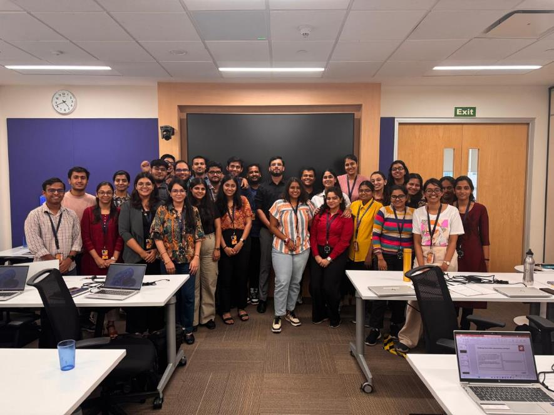
Learning is also Fun!
Fun, interactive and engaging classes
Informative interactions
Team activites with heavy tasks

Slide 17

Summary
The final case study allowed better understanding of topics taught in class
Overall, we covered everything starting from soft skills, BA, devops, Cloud, DBMS, Agile etc.
Being the lead of all the group activites allowed me to learn and refresh leadership skills along with my teamwork skills
All the notes taken allow me to be able to refresh the topics whenever I wish
GitHub link: https://github.com/Aranyaa-k/UNext-Technical-Training.git
GitHub link: https://github.com/Aranyaa-k/Final-Case-Study.git

Slide 18
Thank You

